Slide 1
Seconds weeks

Slide 4
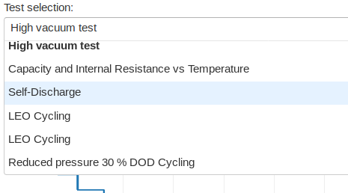
Interfaz: Interaction evolution
Dropbox options

